Slide 1
Introduction to Computer Simulation of Physical Systems
(Lecture 6)
Simulating Particle Motion (CONTINUED)
PHYS 3061

Slide 2
Thermodynamic Quantities
In the following we discuss how some of the macroscopic quantities of interest such as the temperature and the pressure can be related to time averages over the phase space trajectories of the particles.

Slide 3
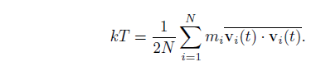
We have already introduced the definition of the kinetic temperature.
The temperature that we measure in a laboratory experiment is the mean temperature, which corresponds to the time average of T(t) over many configurations of the particles.
For two dimensions (d = 2), we write the mean temperature T as

Slide 4
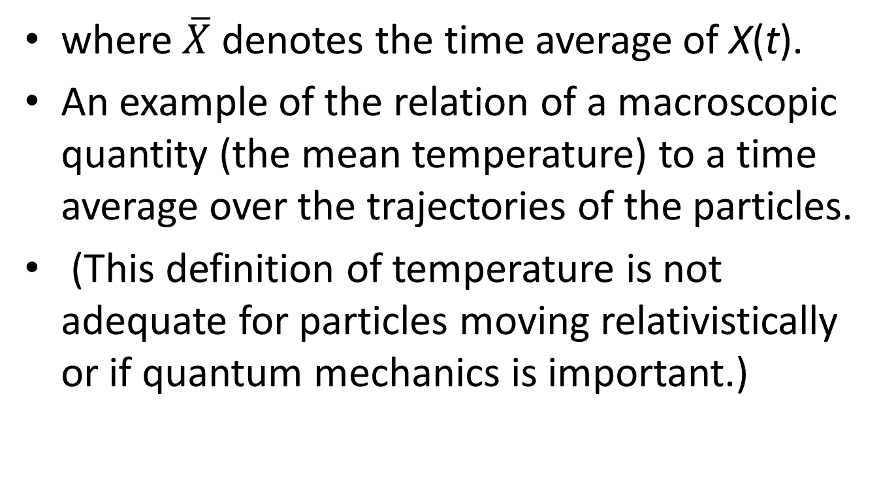
where $\overline{X}$ denotes the time average of X(t).
An example of the relation of a macroscopic quantity (the mean temperature) to a time average over the trajectories of the particles.
(This definition of temperature is not adequate for particles moving relativistically or if quantum mechanics is important.)

Slide 5
The relation holds
  only if the momentum of the center of mass of the system is zero!
we do not want the motion of the center of mass to change the temperature.
In a laboratory system the walls of the container ensure that the center of mass motion is zero

Slide 6
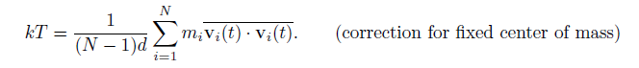
(if the mean momentum of the walls is zero).
In our simulation, we impose the constraint that the center of mass momentum (in each of the d directions) be zero.
Consequently, the system has dN − d independent velocity components rather than dN components, and we should replace the equation by

Slide 7
The presence of the factor (N −1)d rather than Nd is an example of a finite size correction that becomes unimportant for large N.
Another macroscopic quantity of interest is the mean pressure.
The pressure is related to the force per unit area normal to an imaginary surface in the system.
By Newton’s second law, this force is related to the momentum that crosses the surface per unit time.

Slide 8
We could use this relation to determine the pressure, but this relation uses information only from the fraction of particles that are crossing an arbitrary surface at a given time.
Instead, we will use the relation of the pressure to the virial , which involves all the particles in the system.

Slide 9
In general, the momentum flux across a surface has two contributions.
The contribution, NkT/V , where V is the volume (area) of the system, is due to the motion of the particles and is derived in many texts using simple kinetic theory arguments.

Slide 10
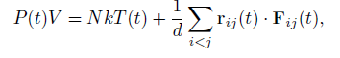
The other contribution to the momentum flux arises from the momentum transferred across the surface due to the forces between particles on different sides of the surface.
It can be shown that the instantaneous pressure at time t including both contributions to the momentum flux is given by

Slide 11
where r_{ij} = r_{i} − r_{j} and F_{ij} is the force on particle i due to particle j.
The second term is related to the virial and represents the correction to the ideal gas equation of state due to the interactions between the particles.
  (In two and one dimensions, we replace V by the area and length, respectively.)
  Virial theorem is an important theory on the relation between average kinetic energy and virial of stable systems, proposed by Rudolf Clausius
    For detailed description and derivation: https://en.wikipedia.org/wiki/Virial_theorem
    https://en.wikipedia.org/wiki/Virial_stress

Slide 12
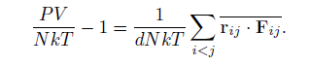
The mean pressure, P = P(t), is found by computing the time average of the right-hand side of the above equation.
The computed quantity is not P, but the ratio

Slide 13
The relation of information
  at the microscopic level to macroscopic quantities
  such as: the temperature and pressure
  one of the fundamental results of statistical mechanics.
In brief, molecular dynamics
  allows us to compute various time averages of the trajectory
    in phase space over finite time intervals.

Slide 14
One practical question:
  whether our time intervals are sufficiently long to allow the system to explore phase space and yield meaningful averages?
Calculations in statistical mechanics are done by replacing time averages by ensemble averages over all possible configurations.

Slide 15
The quasi-ergodic hypothesis asserts that these two types of averages give equivalent results if the same quantities are held fixed.
In statistical mechanics, the ensemble of systems at fixed E, V , and N is called the microcanonical ensemble.

Slide 16
Averages in this ensemble correspond to the time averages
  that we use in molecular dynamics
    at fixed E, V and N.
(Molecular dynamics also imposes an additional, but unimportant, constraint on the center of mass motion.)

Slide 17
Another useful thermal quantity is the heat capacity at constant volume,
  defined by the relation C_{V} = (∂E/∂T)_{V} .
  (The subscript V denotes that the partial derivative is taken with the volume held fixed.)
  C_{V} : an example of a linear response function
    the response of the temperature to a change in the energy of the system.

Slide 18
One way to obtain C_{V} is to determine T(E),
  the temperature as a function of E.
    (Remember that a molecular dynamics simulation yields T as a function of E.)
  The heat capacity is given approximately by ΔE/ΔT for two runs that have slightly different temperatures.
  This method is straightforward, but requires that simulations at different energies be done.

Slide 19

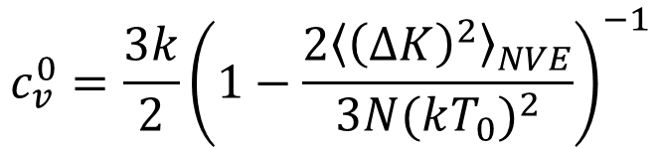
C_{V} is related to the fluctuations of the total energy in the canonical ensemble in which T, V , N are held fixed.
In molecular dynamics simulations
  (supposedly micro canonical ensemble),
  the total energy is fixed, but the kinetic and potential energies can fluctuate.
Another way of determining C_{V} is to relate it to the fluctuations of the kinetic energy. It can be shown that
$$c_{v}^{0}=\frac{3k}{2}{\left(1−\frac{2{\left\langle {\left(∆K\right)}^{2}\right\rangle }_{NVE}}{3N{(kT_{0})}^{2}}\right)}^{−1}$$

Slide 20
Radial Distribution Function
To gain more insight into the structure of a many body system
  looking at how the positions of the particles are correlated with one another due to their interactions.

Slide 21
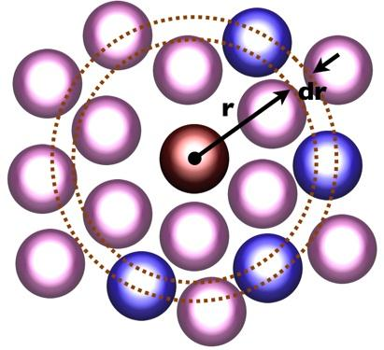
The radial distribution function g(r): a measure of this correlation and has the following properties:
  Suppose that N particles are in a region of volume V with number density ρ = N/V .
  Choose one of the particles to be the origin.
  Then the mean number of other particles between r and r + dr is defined to be ρg(r) dr.
  If the interparticle interaction is spherically symmetric and the system is a gas or a liquid, then g(r) depends only on the separation r = |r|.

Slide 22
The normalization condition for g(r) is
  ρ∫g(r) dr = N − 1 ≈ N,
  the volume element dr = 4πr²dr (d = 3), 2πrdr (d = 2), and 2dr (d = 1).
  if we choose one particle as the origin and count all the other particles in the system, we obtain N − 1 particles.
Question, what’s the g(r) for ideal gas?
  What’s the g(r) for LJ potential?

Slide 23
For an ideal gas, there are no correlations between the particles, and the normalization condition implies that g(r) = 1 for all r.
For the Lennard-Jones interaction, we expect that g(r) → 0 as r → 0,
  because the repulsive force between particles increases rapidly as r → ∞.
g(r) → 1 as r → ∞,
  because the correlation of a given particle with the other particles decreases as their separation increases.

Slide 24
Several thermodynamic properties can be obtained from g(r).
Because ρg(r) can be interpreted as the local density of particles about a given particle, the potential energy of interaction between this particle and all other particles between r and r + dr is u(r)ρg(r)dr,
  if we assume that only two-body interactions are present.

Slide 25
The total potential energy is found by integrating over all r and multiplying by N/2.
Why do we have to divide it with 2?

Slide 26
The result is that the mean potential energy per particle can be expressed as
U/N=(ρ/2) ∫g(r)u(r) dr.
It also can be shown that the relation for the mean pressure can be rewritten in terms of g(r) so that the equation of state can be expressed as
PV/NkT= 1 − (ρ/2kTd) ∫g(r) r (du(r)/dr)dr.

Slide 27
To determine g(r) for a particular configuration of particles,
  we first compute n(r,Δr), the number of particles in a spherical (circular) shell of radius r
  and a small, but nonzero width Δr,
    with the center of the shell centered about each particle.
  A method for computing n(r) is given in next page.

Slide 28
The use of periodic boundary conditions in computeRDF implies that
  the maximum separation between any two particles in the x and y direction is Lx/2 and Ly/2, respectively.
  Hence, we can determine g(r) only for r ≤ 1/2 min(Lx,Ly)

Slide 29
To obtain g(r) from n(r), we note that for a given particle i, we consider only those particles whose index j is greater than the index i (see computeRDF).
Hence, there are a total of 1/2N(N −1) separations that are considered.

Slide 30
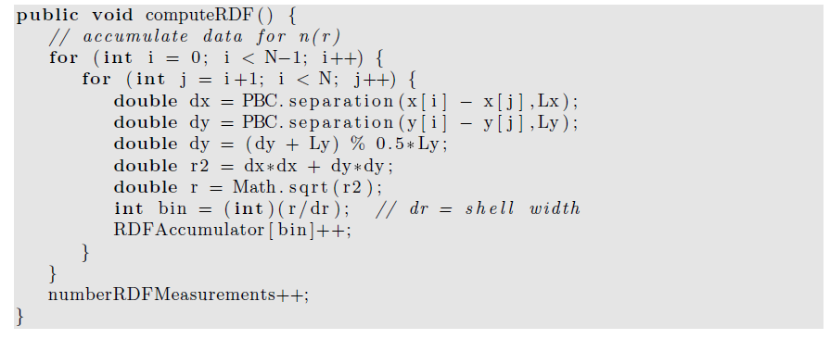
j

Slide 31
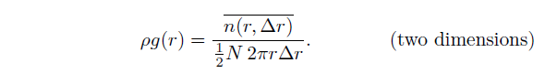
In two dimensions we compute n(r,Δr) for a circular shell whose area is 2πrΔr.
These considerations imply that g(r) is related to n(r) by
Note the factor of N/2 in the denominator. Method normalizeRDF normalizes the array
RDFAccumulator and yields g(r)

Slide 32
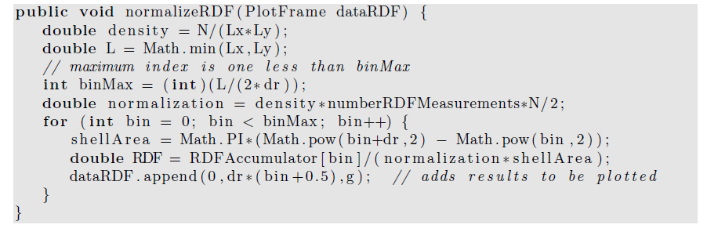
The shell thickness Δr needs to be sufficiently small so that the important features of g(r) are found, but large enough so that each bin has a reasonable number of contributions. The value of Δr should be a class variable. A reasonable choice for its magnitude is Δr = 0.025.

Slide 33
Dynamical Properties
The concept of a collision is not well-defined for systems with a continuous interaction such as the Lennard-Jones potential.
In the following, we take a more general approach to the dynamics of a many body system and discuss how the transport of particles in a system near equilibrium is related to the equilibrium properties of the system.

Slide 34
The trajectory of a particular particle,
  for example, particle 1, in a system that is in equilibrium.
  At some arbitrarily chosen time t = 0, its position is r1(0).
  At a later time t, its displacement is r1(t) − r1(0).

Slide 35
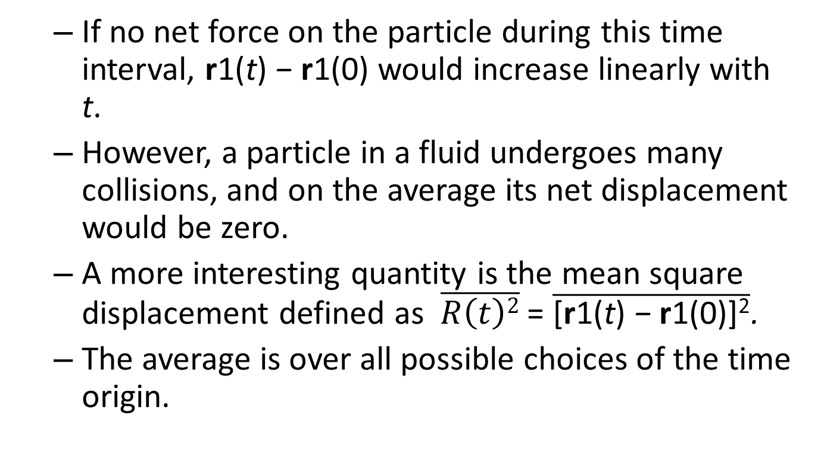
  If no net force on the particle during this time interval, r1(t) − r1(0) would increase linearly with t.
  However, a particle in a fluid undergoes many collisions, and on the average its net displacement would be zero.
  A more interesting quantity is the mean square displacement defined as $\overline{R\left(t\right)2}$ = $\overline{\text{[}\text{r}\text{1(}\text{t}\text{) }\text{− }\text{r}\text{1(0)]}\text{2}}$.
  The average is over all possible choices of the time origin.

Slide 36
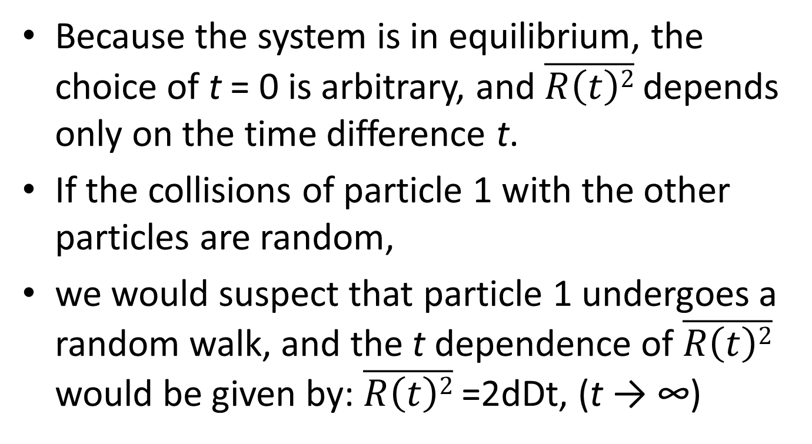
Because the system is in equilibrium, the choice of t = 0 is arbitrary, and $\overline{R\left(t\right)2}$ depends only on the time difference t.
If the collisions of particle 1 with the other particles are random,
we would suspect that particle 1 undergoes a random walk, and the t dependence of $\overline{R\left(t\right)2}$ would be given by: $\overline{R\left(t\right)2}$ =2dDt, (t → ∞)

Slide 37
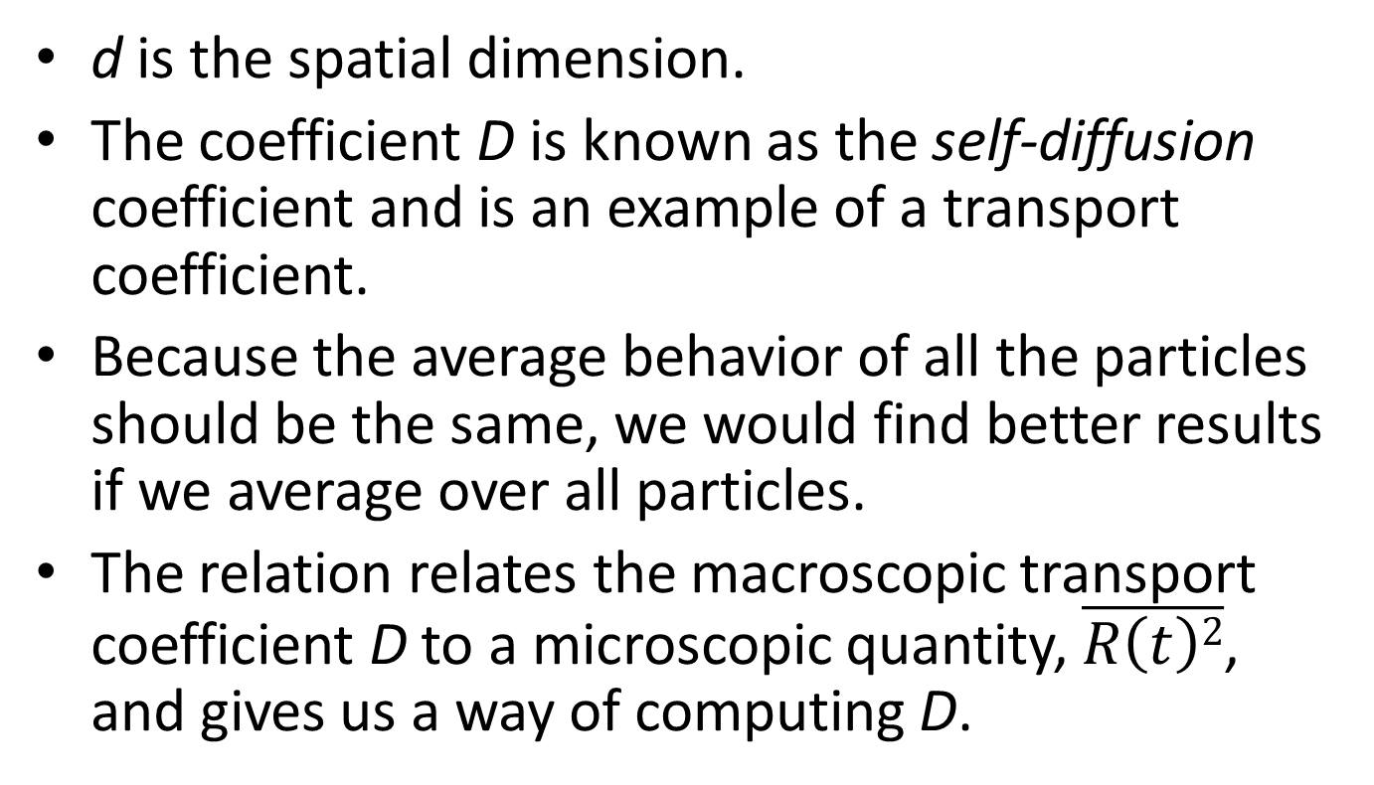
d is the spatial dimension.
The coefficient D is known as the self-diffusion coefficient and is an example of a transport coefficient.
Because the average behavior of all the particles should be the same, we would find better results if we average over all particles.
The relation relates the macroscopic transport coefficient D to a microscopic quantity, $\overline{R\left(t\right)2}$, and gives us a way of computing D.

Slide 38
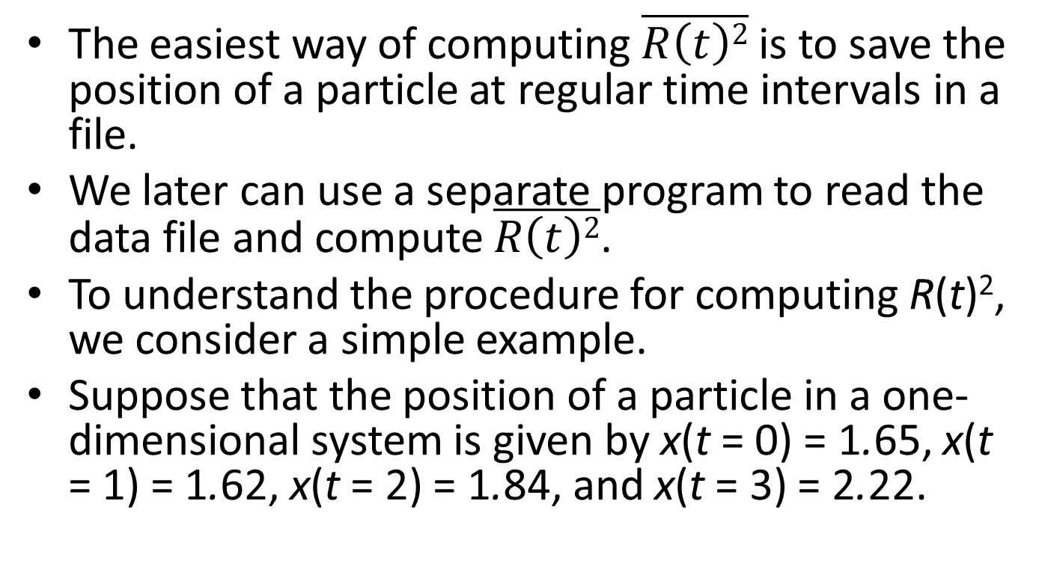
The easiest way of computing $\overline{R\left(t\right)2}$ is to save the position of a particle at regular time intervals in a file.
We later can use a separate program to read the data file and compute $\overline{R\left(t\right)2}$.
To understand the procedure for computing R(t)², we consider a simple example.
Suppose that the position of a particle in a one-dimensional system is given by x(t = 0) = 1.65, x(t = 1) = 1.62, x(t = 2) = 1.84, and x(t = 3) = 2.22.

Slide 39
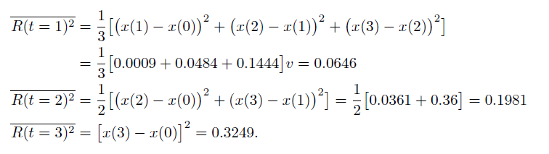
If we average over all possible time origins, we obtain

Slide 40
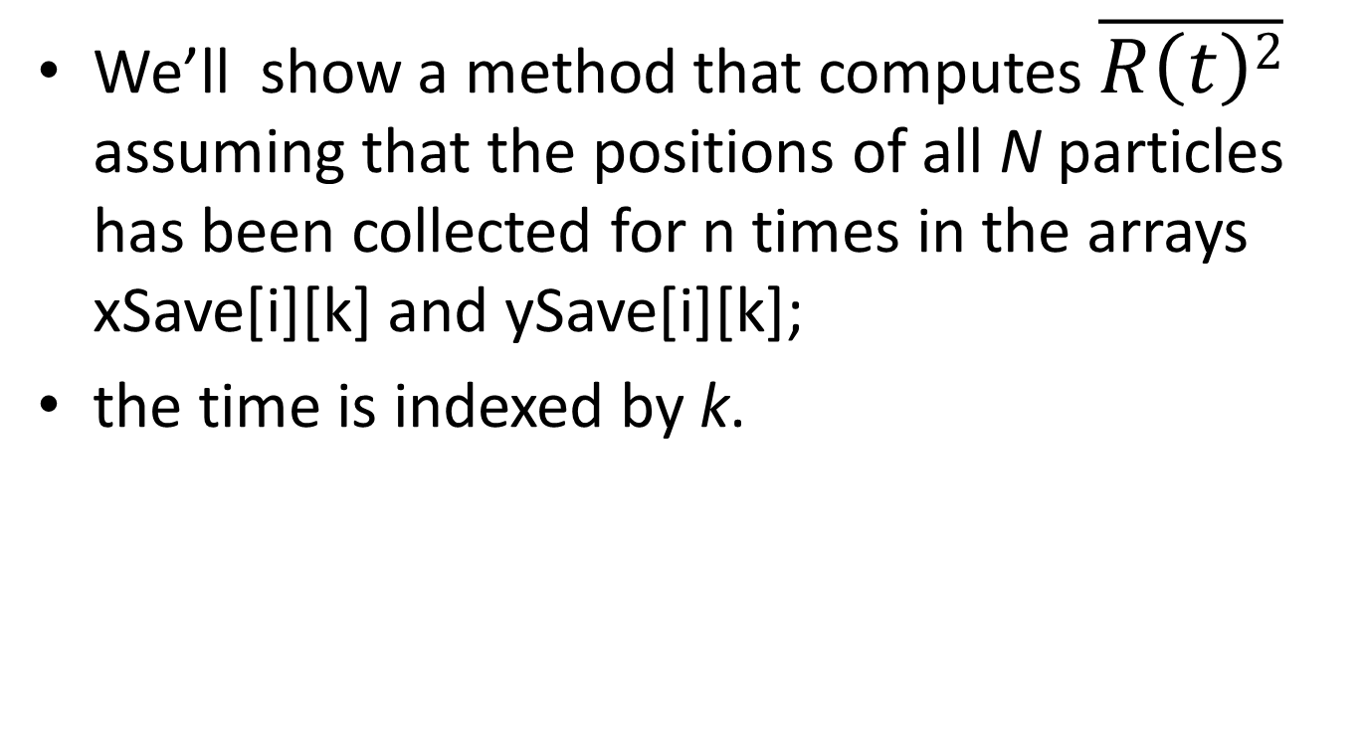
We’ll show a method that computes $\overline{R\left(t\right)2}$ assuming that the positions of all N particles has been collected for n times in the arrays xSave[i][k] and ySave[i][k];
the time is indexed by k.

Slide 41
we cannot find the distance moved by a particle by just keeping track of its position.
  Because of periodic boundary conditions,
  Imagine that a particle moved in only one direction
    and returned to its original position.

Slide 42
If we just subtracted the coordinates of the position,
  we would find that the particle’s displacement was zero
    when in fact it really moved an amount equal to the length of the simulation cell.
How to solve this problem?

Slide 43
To keep track of the movement of each particle, we use two arrays, xWrap and yWrap.
Every time particle i moves past the right boundary in the time interval k*dk to (k+1)*dk, xWrap[i][k] is incremented by Lx.
Similarly, each time the particle moves past the left boundary xWrap[i][k] is decremented by Lx.
A similar procedure is used for yWrap.

Slide 44
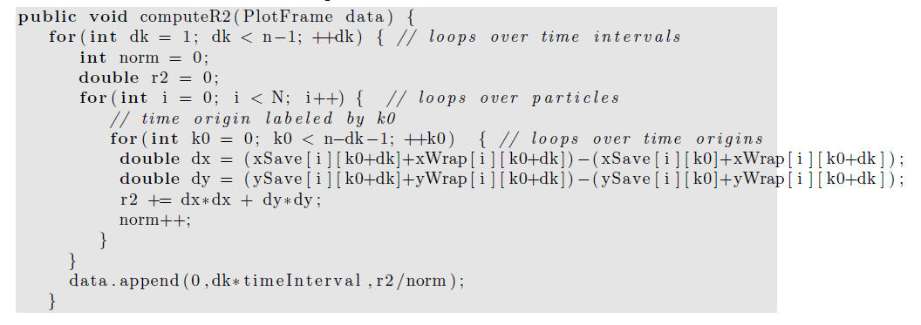
Textbook error!

Slide 45
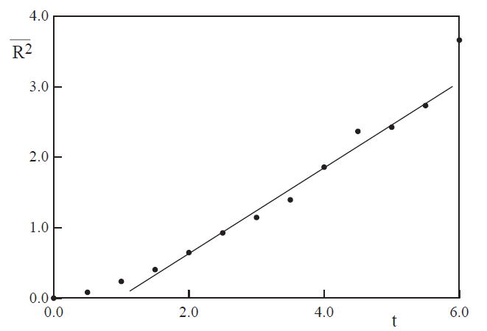
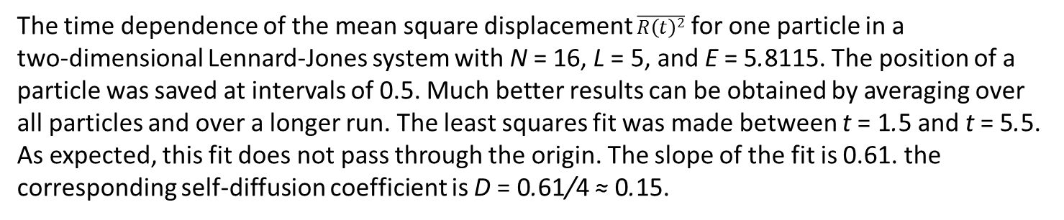
The time dependence of the mean square displacement $\overline{R\left(t\right)2}$ for one particle in a
two-dimensional Lennard-Jones system with N = 16, L = 5, and E = 5.8115. The position of a
particle was saved at intervals of 0.5. Much better results can be obtained by averaging over all particles and over a longer run. The least squares fit was made between t = 1.5 and t = 5.5. As expected, this fit does not pass through the origin. The slope of the fit is 0.61. the
corresponding self-diffusion coefficient is D = 0.61/4 ≈ 0.15.

Slide 46
Another physically important property is the velocity autocorrelation function C(t).
Suppose that particle i has velocity vi at time t = 0.
If there were no net force on particle i, its velocity would remain constant.

Slide 47
However, its interactions with other particles in the fluid will change the particle’s velocity,
and we expect that after several collisions,
its velocity will not be strongly correlated with its velocity at an earlier time.

Slide 48
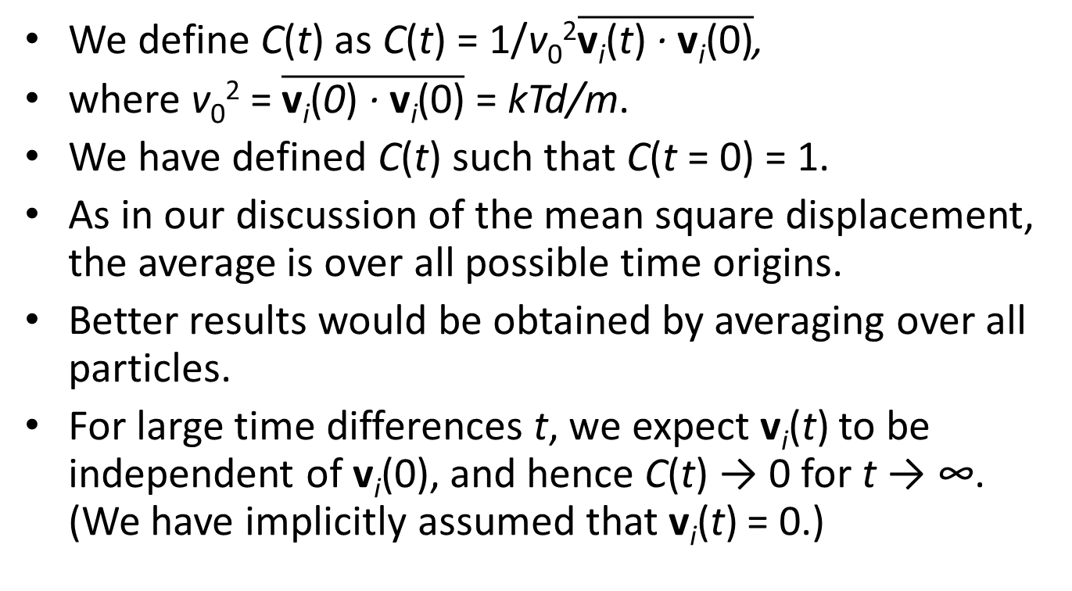
We define C(t) as C(t) = 1/v₀²$\overline{\text{v}\text{i}\text{(}\text{t}\text{) }\text{· }\text{v}\text{i}\text{(0)}}$,
where v₀² = $\overline{\text{v}\text{i}\text{(}\text{0}\text{) }\text{· }\text{v}\text{i}\text{(0)}}$ = kTd/m.
We have defined C(t) such that C(t = 0) = 1.
As in our discussion of the mean square displacement, the average is over all possible time origins.
Better results would be obtained by averaging over all particles.
For large time differences t, we expect v_{i}(t) to be independent of v_{i}(0), and hence C(t) → 0 for t → ∞. (We have implicitly assumed that v_{i}(t) = 0.)

Slide 49
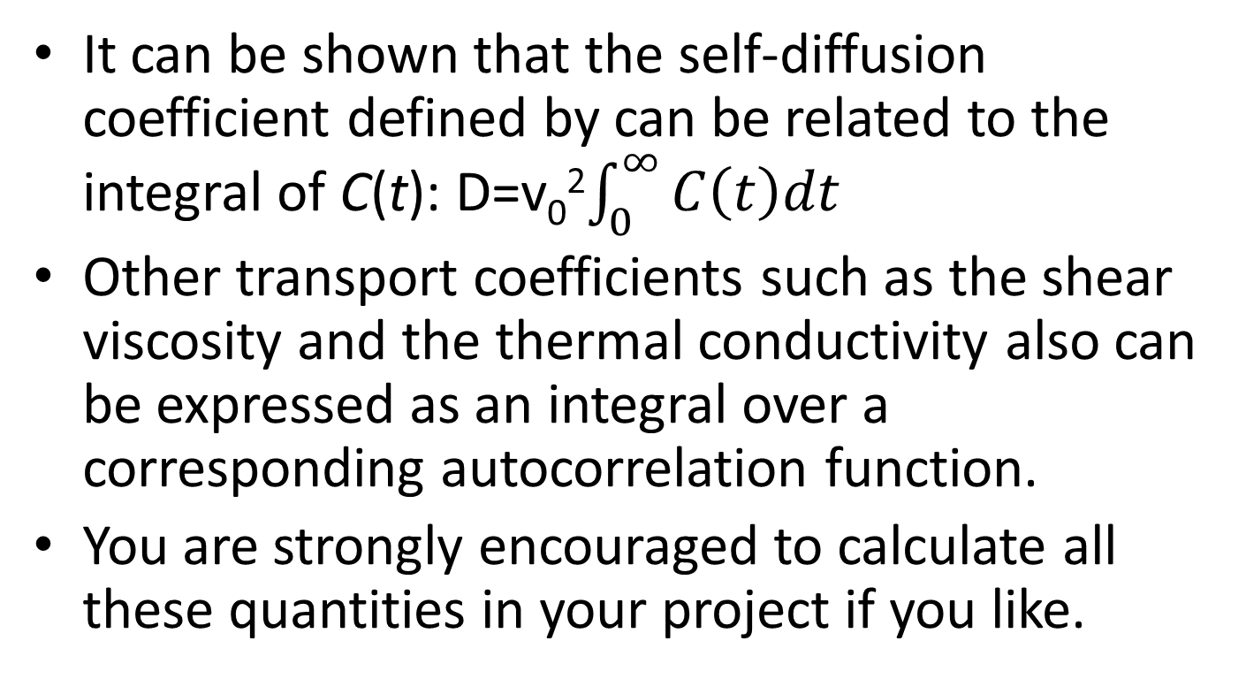
It can be shown that the self-diffusion coefficient defined by can be related to the integral of C(t): D=v₀²$\int_{0}^{∞}{C\left(t\right)dt}$
Other transport coefficients such as the shear viscosity and the thermal conductivity also can be expressed as an integral over a corresponding autocorrelation function.
You are strongly encouraged to calculate all these quantities in your project if you like.

Slide 50
Heat bath
To implement canonical ensemble, we need to fix the temperature.
  Also, such practice can largely reduce the error accumulation in Verlet algorithm.

Slide 51
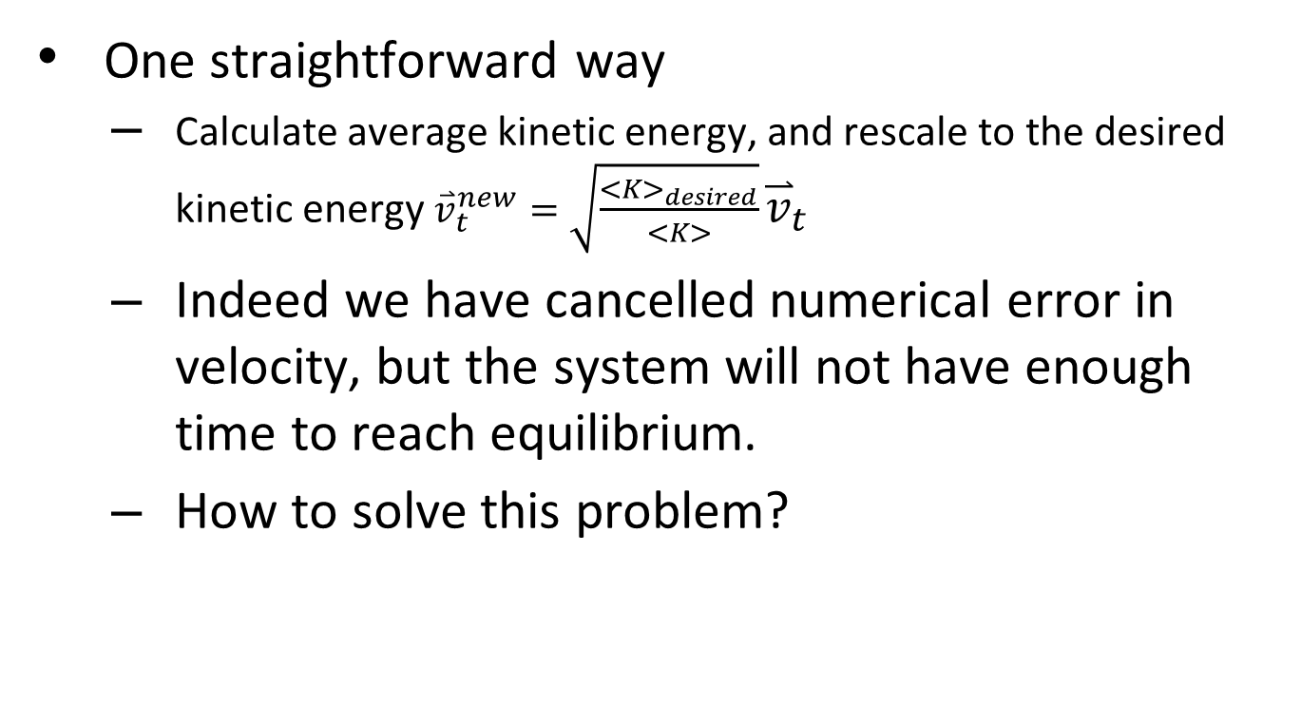
To rescale velocity?
One straightforward way
  Calculate average kinetic energy, and rescale to the desired kinetic energy ${\overset{⃑}{v}}_{t}^{new}=\sqrt{\frac{<K>_{desired}}{<K>}}{\overset{⃑}{v}}_{t}$
  Indeed we have cancelled numerical error in velocity, but the system will not have enough time to reach equilibrium.
  How to solve this problem?

Slide 52
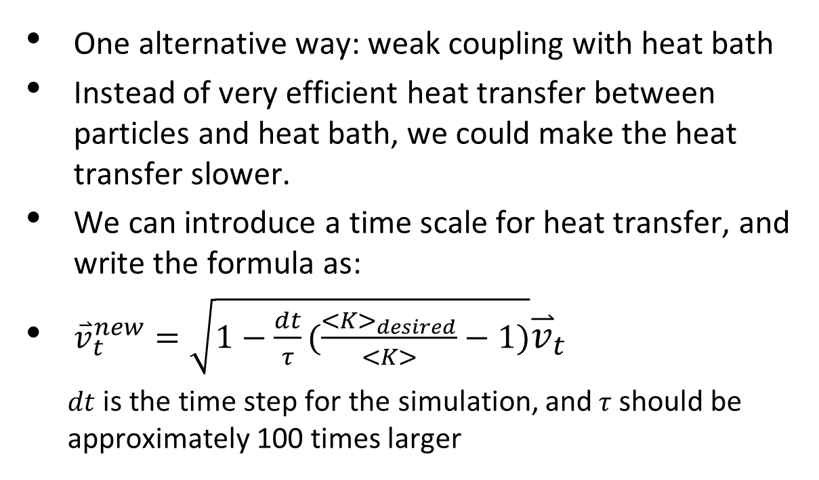
Implementation of heat bath
How to rescale velocity?
One alternative way: weak coupling with heat bath
Instead of very efficient heat transfer between particles and heat bath, we could make the heat transfer slower.
We can introduce a time scale for heat transfer, and write the formula as:
${\overset{⃑}{v}}_{t}^{new}=\sqrt{1−\frac{dt}{τ}(\frac{<K>_{desired}}{<K>}−1)}{\overset{⃑}{v}}_{t}$
  $dt$ is the time step for the simulation, and$τ$ should be approximately 100 times larger

